Slide 1



Professional Skills
Unit-1
Resume Skills and Interview Skills

Slide 2
What is a Resumé?
Definition: A French word meaning "summary“
Summary of a person's education, skills, and employment
Usually one or two pages long
Customized to the target job profile
Written in third person for objective, formal tone

Slide 3
What Is a Curriculum Vitae (CV)?
Curriculum Vitae (CV):​
“Curriculum vitae” is a Latin term.
More detailed than a Resumé, generally two to three pages or longer, as required.
Lists every skill, all jobs and positions held, degrees, and professional affiliations in chronological order.
Highlights professional and academic history: work experience, achievements, awards, scholarships, grants, coursework, research projects, and publications.
Used to highlight overall talent, not just specific skills for a specific position.

Slide 4
What Is Biodata?
Biodata (Biographical Data):​
Short form for “Biographical Data”; an older term for Resumé or CV.
Focus on personal particulars: date of birth, gender, religion, race, nationality, residence, marital status, etc.
Chronological listing of education and experience comes after personal details.

Slide 5
CV, Resumé, Biodata: Usage
Differences in Usage:​
CV and Resumé both summarize professional history, education, skills, and achievements.
In the United States and most of Europe, CV and Resumé are not interchangeable.
In India, South Africa, and Australia, the terms CV and Resumé are often interchangeable.
The term biodata is mostly used in India, usually for government jobs.

Slide 6
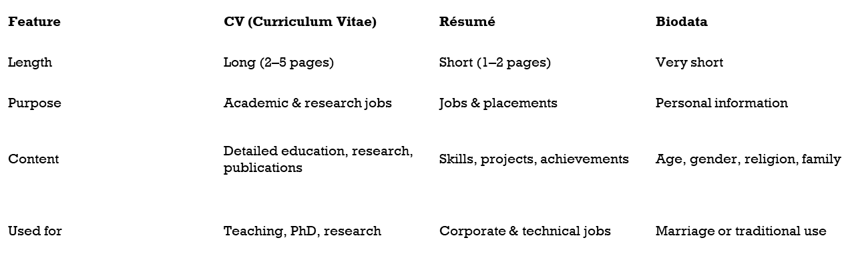
CV, Resumé, Biodata: Difference

Slide 7
Importance of a Good Resumé
Why Prepare a Good Resumé/CV?​
A Resumé is a mirror reflection of a candidate’s pursuits.
Employers require Resumés to consider candidates for positions.
Used first to weed out unlikely candidates.
Rejected due to: errors in presentation and spelling, inappropriate appearance, incomplete details.
Shortlisted resumés are reviewed for education, training, community involvement, life experiences, and other suitability indicators.
Therefore, preparing an impressive resumé is vital.

Slide 8
Essential Structure of a Good Resumé
Overall Structure:​
Starts with a brief profile of the candidate.
Followed by summary of qualifications.
Then industry expertise.
Professional experience in reverse chronological order (focus on most recent, with responsibilities and accomplishments).
Previous experiences as summary/additional information.
Education details and/or professional affiliations and/or voluntary initiatives follow.

Slide 9
Principal Areas: Contact Information
Contact Information (Mandatory):​
Name.
Postal address.
Telephone number(s): work, home, mobile (as applicable).
E-mail address.

Slide 10
Principle Areas: Career Objective
2–3 line statement
Mentions goal, skills, and aspiration
Example:
Motivated B.Tech CSE student seeking opportunities to apply technical skills

Slide 11
Principal Areas: Education & Training
Provides information on formal education and professional training.
As a learner entering the workforce, educational credentials should be at the top of the Resumé.
List highest level of education first, then work backwards.
List specialization or professional training related to job objective first.
Include any special honours or rewards.
List courses, seminars, workshops, training as part of professional development and recent positions related to career focus.

Slide 12
Principle Areas: Technical Skills and Soft Skills
Technical Skills such as:
Programming Languages
Tools and Software
Technologies
Soft Skills such as:
Communication skills
Teamwork
Problem-solving
Time management

Slide 13
Principle Areas: Projects/Internships
Project Title
Tools or technologies used
One-line description
Mini projects are acceptable

Slide 14
Additional Components (Optional)
Publications/presentations (divide by topic if long; can include work “in preparation”).
Special skills (e.g., computer hardware/software, language skills) when job requires expertise.
Certificates and training relevant to the job.
Associations/affiliations: current memberships or active involvement in professional/civic bodies linked to job objective.
Awards/honours and recognitions: career-related, precise and specific, without self-praise.
Work history: main body of Resumé when applying for a new job.

Slide 15
Common Resumé Errors
Spelling and grammatical errors, especially among freshers.
Not including keywords that match the job position.
An outdated resumé: not updating skills, contact details, current location, etc.
Including too much information instead of relevant content.
Career summary that does not match job requirements.
Leading paragraphs with irrelevant duties.
Being too modest about accomplishments and rewards.

Slide 16
Resumé Preparation Guidelines
Use good quality paper.
Send a good quality photocopy.
Ideally, Resumé should not exceed one or two pages.
As a fresher: highlight academic achievements, workshops, internships, seminars where skills were acquired/updated.
Include: languages known, hobbies and interests, extra‑curricular activities, positive points in brief.
Select a simple font and appropriate size for clarity and legibility.
Check spelling and grammar before finalizing.

Slide 17
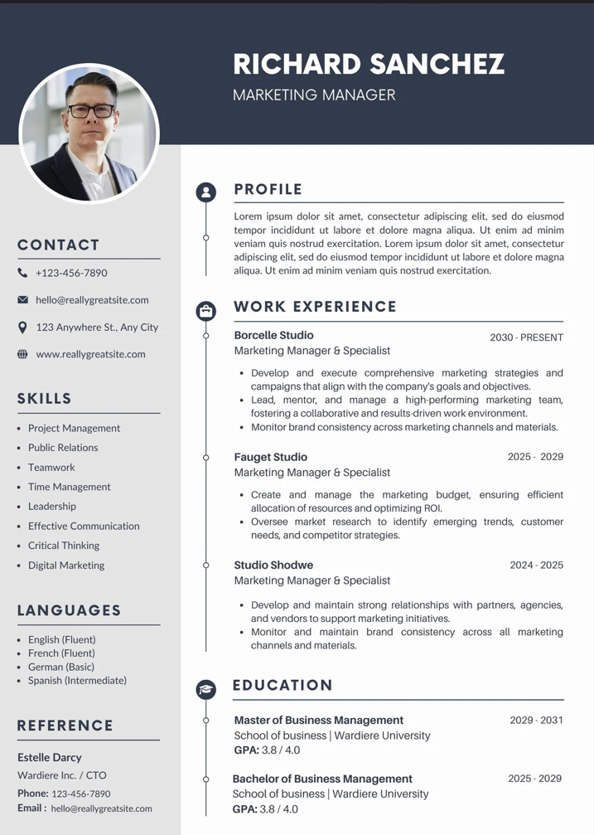
Sample Resumé (Template)
Contact Information: Name, Address, Phone, Email.
Personal details: Marital Status, Date of Birth, Nationality, Languages Known.
Sections: Career Objective, Educational Qualifications, Project, Experience (if any), Technical Skills, Soft Skills, Extra‑Curricular Activities, Achievements, Declaration, Signature.​

Slide 18
Introducing Interview Skills
Link Between Resumé and Interview:​
Usually, candidate submits detailed Resumé before the interview.
During the interview, candidate must present self in limited time.
Employer should get to know the candidate, understand capabilities, and be convinced of suitability for the job.

Slide 19
Meaning of Interview
An interview is a conversation where interviewer(s) ask questions and the interviewee answers.
In a job interview, employer assesses the candidate; job seeker tries to convince the employer.
Sometimes information is transferred in both directions.
Usually face‑to‑face and in person, but can use smartphones or video conferencing when separated geographically.
Generally an oral conversation; in some cases, questions and answers may be typed back and forth.

Slide 20
Types of Interviews
Telephonic Interview: Initial screening via phone call to assess basic qualifications and communication skills remotely.
Face‑to‑face Interview: Traditional in-person meeting where interviewer and candidate discuss fit, skills, and experience directly.
Video Conference Interview: Remote interview using video tools like Zoom, allowing geographic separation while enabling visual interaction.
Selection Interview: Standard process to evaluate and select candidates based on job requirements, often after resume review.
Behavioural Interview: Focuses on past experiences using STAR method (Situation, Task, Action, Result) to predict future performance.
Group or Panel Interview: Multiple interviewers (panel) question one candidate simultaneously, assessing teamwork and responses under group scrutiny.

Slide 21
STAR Approach: Overview
S – Situation: Set the scene and give necessary details of your example.
T – Task: Describe your responsibility in that situation.
A – Action: Explain the steps you took to address it.
R – Result: Share the outcomes of your actions.

Slide 22
STAR in Behavioural Interviews
STAR Response Technique:​
Used in behavioural interviews to answer questions in a structured way.
Questions often start with:
“Tell me about a situation…”
“What do you do when…”
“Have you ever…”
“Share an example of…”
“Describe what you think…”
Answers should give real‑life examples of how the candidate handled past work situations.

Slide 23
Interview Procedure: Overview
The Interview Procedure:​
Candidate submits Resumé with education, experience, and achievements.
During the interview, candidate must present self so employer knows what he/she can do and why he/she is most suitable.
Employers have two primary goals:
Check if candidate is qualified.
Check if candidate will fit into the organization.
Employers view all candidate actions during hiring as examples of ability and work.

Slide 24
Before the Interview (Do’s)
Do the homework: research company and employer; visit website; note functions, staff, important points.
Make a good first impression:
For face‑to‑face: trial run to location, arrive early, carry Resumé/CV, know dates and specifics to discuss.
For video interview: test tool beforehand, set up 15 minutes early, ensure connectivity, quiet, well‑lit, comfortable place; smile confidently and stay engaged.
Treat each interview as a new opportunity; learn from past mistakes; keep gaps between multiple interviews to stay fresh.
Treat everyone in the company with respect (parking staff, receptionist, recruiting staff, other candidates).

Slide 25
During the Interview (Do’s)
Stay relaxed and comfortable.
Greet everyone on the interview board.
Keep job search records organized and handy.
Refer to your Resumé as needed.
Listen carefully; answer clearly and directly, using past examples; respond to the person asking but maintain eye contact with all panel members.
Prepare smart, open‑ended questions to ask interviewer to show interest and motivation and to assess if the role suits you.

Slide 26
During the Interview (More Do’s & Don’ts)
Highlight strengths and expertise by communicating relevant experience and successes.
Never speak negatively about former employers; it reflects on ethics and loyalty.
Be truthful; explain things related to the position and past experiences honestly.
If a question covers your weak area, admit it and show willingness to learn or up‑skill.
Never interrupt the interviewer; be a patient listener and a good speaker.
Thank everyone and take all belongings before leaving quietly.

Slide 27
After the Interview
Reflect on your performance.
Send a “thank you” note or email immediately after the interview.
Show understanding of process, courtesy, commitment to complete the process, and ability to communicate.

Slide 28
Open‑Ended Questions in Interviews
Require more than one‑word answers; may be sentences, a list, or a longer response.
Examples:
How would you describe yourself?
What accomplishments are you particularly proud of?
What do you know about our company, industry and/or position?
Why should we hire you?
Where do you see yourself in two years?
How do you deal with conflict?
Give an example of a time your work was criticized in front of others. How did you respond? What did you learn?

Slide 29
Close‑Ended Questions in Interviews
Can be answered by a simple “yes” or “no” or in one or two words.
Examples:
What is your best quality?
Do you have many friends?
Do you like reading?
When is your birthday?

Slide 30
Common Interview Errors
Reaching late: suggests poor time management and disrespect.
Poor dressing sense: not professional or appropriate to position.
Appearing disinterested: not showing interest through behaviour or intelligent questions.
Not bringing the Resumé: always carry copies even if interviewers have one.
Phone interfering: phone visible or checked during interview; should be switched off and kept aside.
False Resumé: adding false information; makes honest discussion difficult.
Lack of attention: not maintaining eye contact, not leaning forward, not listening with concentration.

Slide 31
Assessing Strengths for Interviews
Strengths – Self‑Assessment:​ Make a list of personal skills/strengths and categorize:
Knowledge‑based skills: education and experience (computer skills, languages, degrees, training, technical ability).
Transferable skills: skills carried from job to job (communication, interpersonal, analytical problem‑solving, planning).
Personal traits: unique qualities (dependable, flexible, friendly, hard working, expressive, punctual, trustworthy, creative, honest, respectful).
Choose 3–5 strengths that match employer’s needs and prepare specific examples.

Slide 32
Answering Strengths & Weaknesses
Example: “As a manager at my previous job, I was able to turn around a negative working environment and develop a very supportive team. As far as weaknesses, I feel that my management skills could be stronger, and I am constantly working to improve.”
Interviewer is looking for a proper fit and forms a picture based on answers.
Focus energy on strengths and what you offer.
Acknowledge shortcomings and show you are working on them.
Job interviews are challenging; being prepared makes a difference.

Slide 33
Common Weaknesses Reported
Assessing Weaknesses (Examples):​
Focus too much on details.
Hard time letting go of a project.
Difficulty in saying “no”.
Get impatient when projects go beyond deadlines.
Need more experience in a particular area.
Lack of confidence sometimes.
Trouble asking for help.
Difficulties working with certain personalities.
Difficulty maintaining healthy work/life balance.
Uncomfortable with ambiguity in the past.

Slide 34
Job Simulation (Mock Interview): Meaning
Simulation – Overview:​
Job simulation is any task designed to give candidates an accurate preview of the role.
Shows what the job entails on a day‑to‑day basis.
Helps companies predict more accurately if a candidate will be successful if selected.

Slide 35
Demonstrating an Ideal Interview
Classroom Focus:​
Simulation: practice interviews, role‑plays, mock interviews, skits.
Comment critically on simulated interviews.
Demonstrate an ideal interview using all skills learned: Resumé preparation, interview preparation, STAR answers, avoiding common errors.

Slide 36
THANK YOU!

